Slide 1
The Greedy Method

Slide 2
General method
Problems have n inputs and acquire us to obtain a subset that satisfies some constraints.
Any subset that satisfies these constraints is called a feasible solution.
GOAL : to find feasible solution that either maximizes or minimizes a given objective function.
Such solution is called Optimal solution.

Slide 3
A simple example
Problem: Pick k numbers out of n numbers such that the sum of these k numbers is the largest.
Algorithm:
FOR i = 1 to k
pick out the largest number and
delete this number from the input.
ENDFOR

Slide 4
The greedy method
Suppose that a problem can be solved by a sequence of decisions. The greedy method has that each decision is locally optimal. These locally optimal solutions will finally add up to a globally optimal solution.
Only a few optimization problems can be solved by the greedy method.

Slide 5
Greedy algorithm
These algorithms work in stages, considering one I/P at a time.
At each stage a decision is made regarding whether a particular input is in an optimal solution.
This is done by considering the inputs in an order determined by some selection procedure.
If the inclusion of the next I/P into partially constructed optimal solution will result in an infeasible solution, then this input is not added to the partial solution. Otherwise its added.

Slide 6
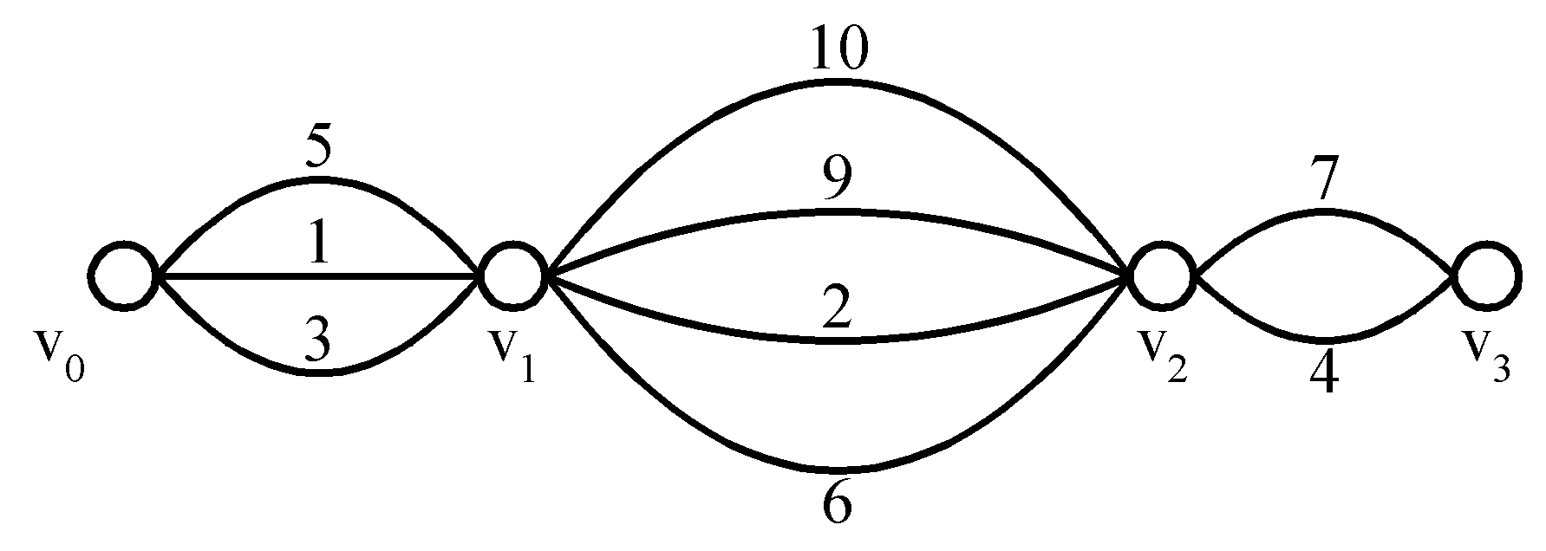
Shortest paths on a special graph
Problem: Find a shortest path from v₀ to v₃.
The greedy method can solve this problem.
The shortest path: 1 + 2 + 4 = 7.

Slide 7
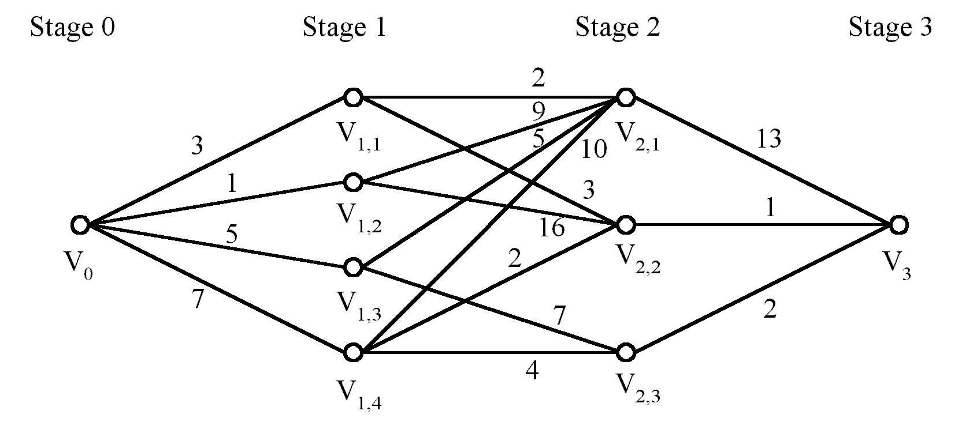
Shortest paths on a multi-stage graph
Problem: Find a shortest path from v₀ to v₃ in the multi-stage graph.
Greedy method: v₀v_{1,2}v_{2,1}v₃ = 23
Optimal: v₀v_{1,1}v_{2,2}v₃ = 7
The greedy method does not work.

Slide 8
Solution of the above problem
d_{min}(i,j): minimum distance between i and j.
This problem can be solved by the dynamic programming method.

Slide 9
Greedy Method (General Algo)
Algorithm Greedy(a,n)
{
// a[1:n] contains n inputs
Solution = nil; //initial solution
for i=1 to n do
{ x = select(a);
if feasible(solution,x) then
solution = union (solution,x);
}
return solution;
}

Slide 10
Some examples
Minimum Spanning Trees
Activity Scheduling
Job Sequencing
Graph coloring
Coinage problem

Slide 11
Coinage Problem
Problem : To give change of n units , given a set of denominations, what is the minimum number of coins to use.
Example: Denominations of coins :
1,5,10,20,50,100
Amount = 647
We want to find minimum number of coins

Slide 12
Coinage Problem
Algorithm : Always take a coin of largest possible denomination and then repeat on the remaining amount due.
1,5,10,20,50,100
Amount = 647
Min coins : 100 x 6 = 600
20 x 2 = 40
5 x 1 = 5
1 x 2 = 2
-------------------------
647 min coins = 11

Slide 13
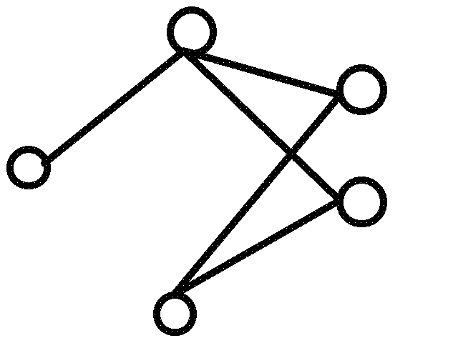
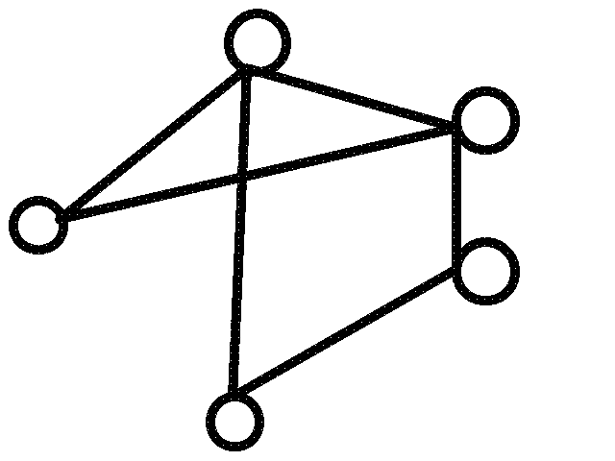
Graph coloring Definition
A coloring of a simple graph is the assignment of a color to each vertex of the graph so that no two adjacent vertices are assigned the same color.

Slide 14
Chromatic Number
The chromatic number of a graph is the least number of colors required to do a coloring of a graph

Slide 15
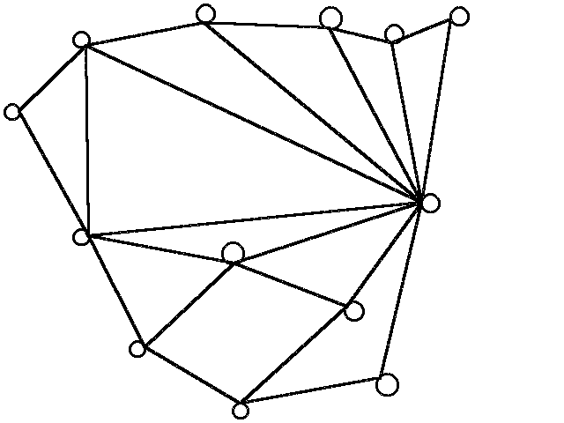
What is the chromatic number of this graph?

Slide 16
Algorithm
Assign color 1 to the vertex with highest degree.
Also assign color 1 to any vertex that is not connected to this vertex.
Assign color 2 to the vertex with the next highest degree that is not already colored.
Also assign color 2 to any vertex not connected to this vertex and that is not already colored.
If uncolored vertices remain, assign color 3 to the uncolored vertex with next highest degree and other uncolored, unconnected vertices.
Proceed in this manner until all vertices are colored.

Slide 17
1
2
3
4

Slide 18
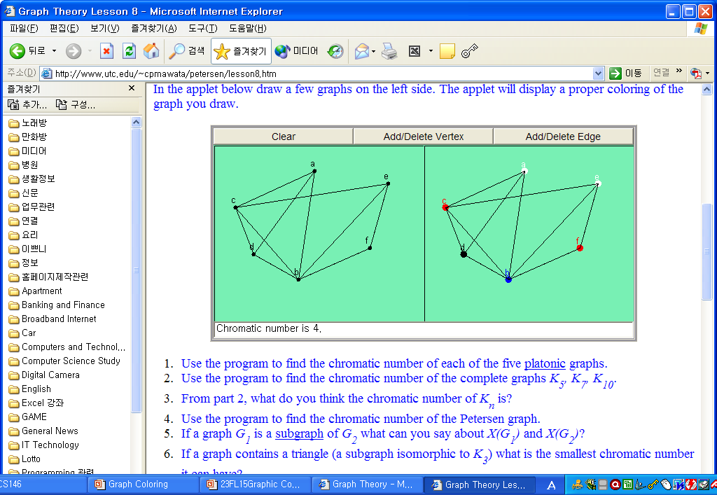
Practice

Slide 19
1
2
1
2
3
3
4
5
4
5
6
6
7
7

Slide 20
1
1
2
6
2
6
7
7
3
5
3
5
4
4

Slide 21
Application
e.g. Scheduling Final Exams
Suppose you want to schedule final exams and, being very considerate, you want to avoid having a student do more than one exam a day. We shall call the courses 1,2,3,4,5,6,7. In the table below a star in entry ij means that course i and j have at least one student in common so you can't have them on the same day. What is the least number of days you need to schedule all the exams? Show how you would schedule the exams.

Slide 22
. | 1 | 2 | 3 | 4 | 5 | 6 | 7
1 | . | * | * | * | - | * | *
2 | * | . | * | - | - | - | *
3 | * | * | . | * | - | - | -
4 | * | - | * | . | * | * | -
5 | - | - | - | * | . | * | -
6 | * | - | - | * | * | . | *
7 | * | * | - | - | - | * | .

Slide 23
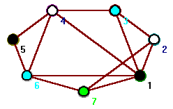
. | 1 | 2 | 3 | 4 | 5 | 6 | 7
1 | . | * | * | * | - | * | *
2 | * | . | * | - | - | - | *
3 | * | * | . | * | - | - | -
4 | * | - | * | . | * | * | -
5 | - | - | - | * | . | * | -
6 | * | - | - | * | * | . | *
7 | * | * | - | - | - | * | .
Day | Exam
1 | 1, 5
2 | 2, 4
3 | 3, 6
4 | 7

Slide 24
Knapsack problem
Given weights and values of n items, we need put these items in a knapsack of capacity W to get the maximum total value in the knapsack.
In the 0-1 Knapsack problem, we are not allowed to break items. We either take the whole item or don’t take it.
In Fractional Knapsack, we can break items for maximizing the total value of knapsack. This problem in which we can break item also called fractional knapsack problem

Slide 25
Input:
Items as (value, weight) pairs
arr[] = {{60, 10}, {100, 20}, {120, 30}}
Knapsack Capacity, W = 50
Output:
Maximum possible value = 240
By taking full items of 10 kg, 20 kg and 2/3rd of last item of 30 kg

Slide 26
algorithm
calculate the ratio value/weight for each item and sort the item on basis of this ratio.
Then take the item with highest ratio and add them until we can’t add the next item as whole and at the end add the next item as much as we can.
always be optimal solution of this problem.

Slide 27
Job scheduling with deadline
Given an array of jobs where every job has a deadline and associated profit if the job is finished before the deadline. It is also given that every job takes single unit of time, so the minimum possible deadline for any job is 1. How to maximize total profit if only one job can be scheduled at a time.

Slide 28
jobs | J1 | J2 | J3 | J4 | J5
profit | 10 | 20 | 15 | 5 | 80
deadline | 3 | 3 | 3 | 4 | 4
Sort according to profit (descending)
Since max deadline is 4, max number of jobs which can be scheduled is 4.
Start filling from end
Total profit: 10+15+20+80 = 125
jobs | J5 | J2 | J3 | J1 | J4
profit | 80 | 20 | 15 | 10 | 5
deadline | 4 | 3 | 3 | 3 | 4
1 | 2 | 3 | 4
J1 | J3 | J2 | J5

Slide 29
Activity selection problem/ class scheduling/ interval scheduling
You are given n activities with their start and finish times. Select the maximum number of activities that can be performed by a single person, assuming that a person can only work on a single activity at a time.
Consider the following 6 activities sorted by by finish time.
start[] = {1, 3, 0, 5, 8, 5};
finish[] = {2, 4, 6, 7, 9, 9};
A person can perform at most four activities. The maximum set of activities that can be executed is
{0, 1, 3, 4}
The greedy choice is to always pick the next activity whose finish time is least among the remaining activities and the start time is more than or equal to the finish time of previously selected activity.

Slide 30
1) Sort the activities according to their finishing time 2) Select the first activity from the sorted array and print it. 3) Do following for remaining activities in the sorted array. …….a) If the start time of this activity is greater than or equal to the finish time of previously selected activity then select this activity and print it.

Slide 31
Minimum spanning trees (MST)
It may be defined on Euclidean space points or on a graph.
G = (V, E): weighted connected undirected graph
Spanning tree : S = (V, T), T ⊆ E, undirected tree
Minimum spanning tree(MST) : a spanning tree with the smallest total weight.

Slide 32
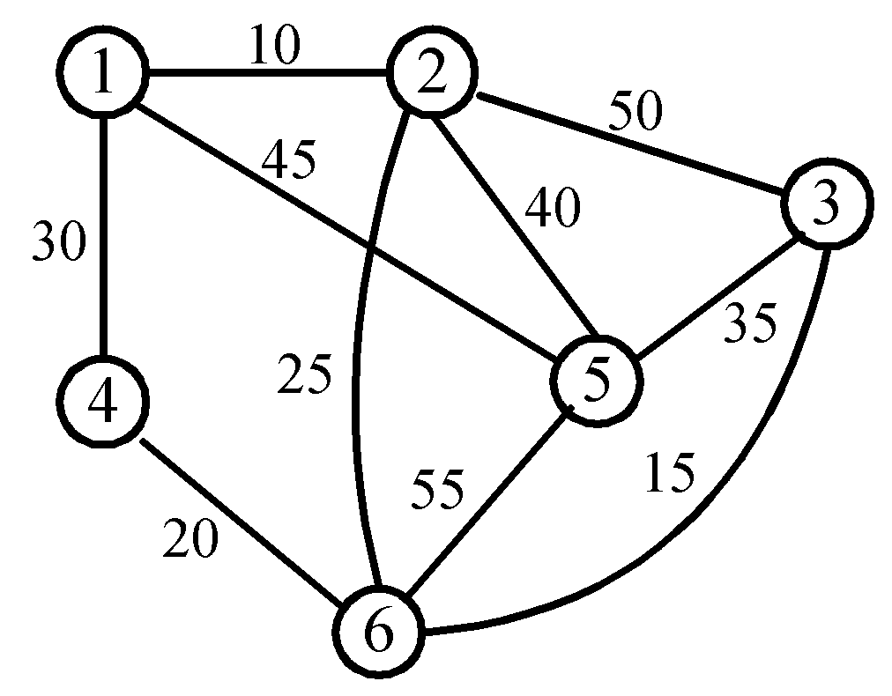
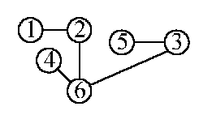
An example of MST
A graph and one of its minimum costs spanning tree

Slide 33
Kruskal’s algorithm for finding MST
Step 1: Sort all edges into nondecreasing order.
Step 2: Add the next smallest weight edge to the forest if it will not cause a cycle.
Step 3: Stop if n-1 edges. Otherwise, go to Step2.

Slide 34
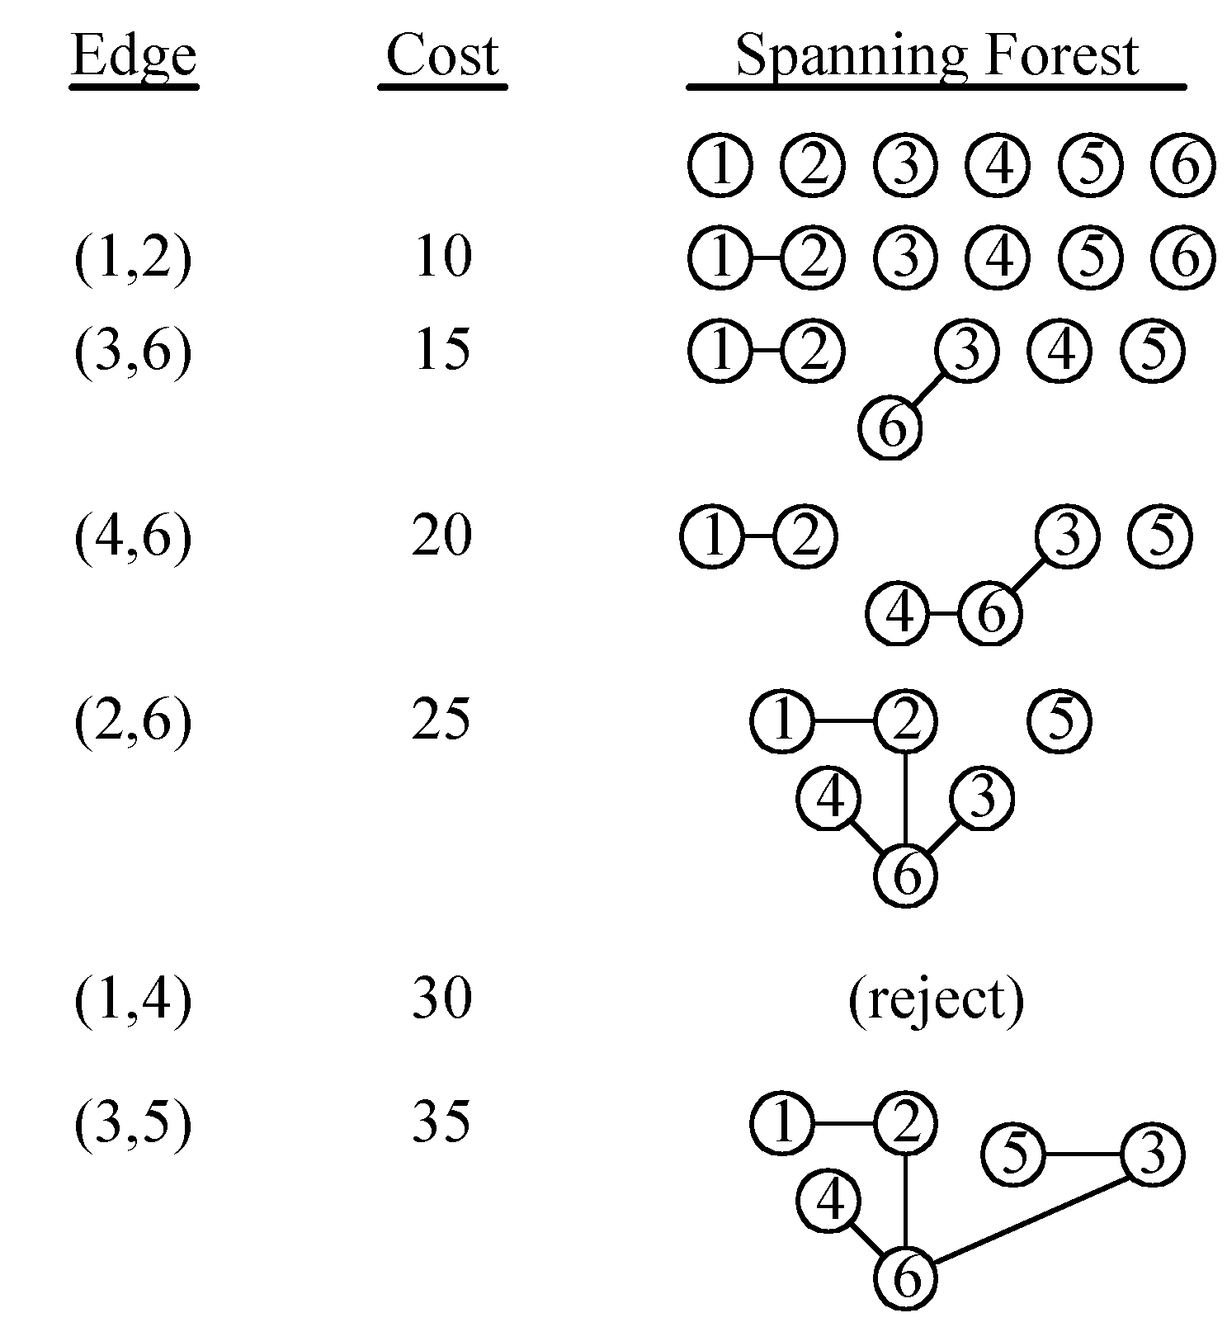
An example of Kruskal’s algorithm

